Slide 1
Introduction and 1-D Kinematics
OpenStax High School Physics
Unit 1
Notes:
NAD 2023 Standards: Motion M1, M2, M3

Slide 2
Credits
This Slideshow was developed to accompany the textbook
  OpenStax High School Physics
    Available for free at https://openstax.org/details/books/physics
    By Paul Peter Urone and Roger Hinrichs
    2020 edition
Some examples and diagrams are taken from the OpenStax College Physics, Physics, and Cutnell & Johnson Physics 6th ed.
Slides created by
Richard Wright, Andrews Academy
rwright@andrews.edu

Slide 3
1-01 Introduction, Units, and Uncertainty
In this lesson you will…
• Explain the difference between a model and a theory.
• Perform unit conversions both in the SI and English units.
• Explain the most common prefixes in the SI units and be able to write them in scientific notation.
• Determine the appropriate number of significant figures in both addition and subtraction, as well as multiplication and division calculations.
Notes:
OpenStax High School Physics 1.1-1.3
OpenStax College Physics 2e 1.1-1.4

Slide 4
1-01 Introduction, Units, and Uncertainty
Physics is the study of the rules (usually stated mathematically) by which the physical world operates.
These rules describe “how” things happen. Laws of Nature
These rules don’t say “why” things happen. Physicists are most interested in being able to predict what will happen. Many physicists think that because they can say how things happen, they have answered the why.
Why does gravity pull things together? Newton described the effects over 100 years before anyone asked why gravity happened. Einstein suggested that mass bends space-time, but that is just a model.
Physics deals with “how”. “Why” is philosophy.

Slide 5
1-01 Introduction, Units, and Uncertainty
I believe God created the laws of physics.
Since He made the laws, He can stop the effects of those laws when He chooses. This is called a miracle.
Many scientists think that because they can describe nature so well without using God that it proves God does not exist.
I believe being able to describe these intricate, interrelated laws shows the wisdom and might of God. It allows for miracles.
God’s laws of nature don’t change, neither do His other laws like, “Treat other how you would like to be treated” or the 10 Commandments. Following His laws makes everything work better.

Slide 6
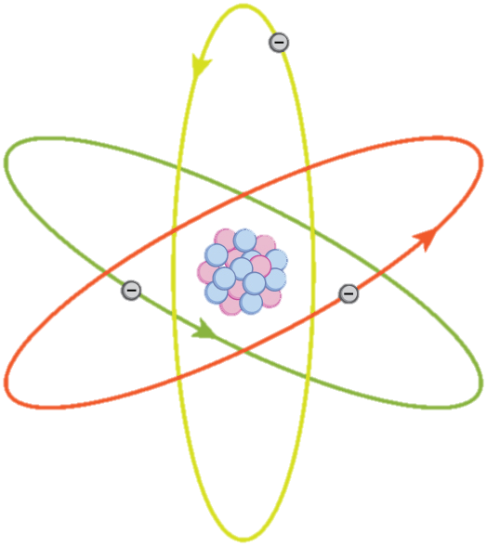
1-01 Introduction, Units, and Uncertainty
Physics studies anything that can be sensed with our five senses.
Model, Theory, Law
  Model
    A representation of something that is often too difficult (or impossible) to display directly.
    It is only accurate under limited situations.
  Theory
    an explanation for patterns in nature that is supported by scientific evidence and verified multiple times by various groups of researchers.
  Law
    Uses concise language to describe a generalized pattern in nature that is supported by scientific evidence and repeated experiments.
    Often, a law can be expressed in the form of a single mathematical equation.
Notes:
The models, theories, and laws we devise sometimes imply the existence of objects or phenomena as yet unobserved.
However, if experiment does not verify our predictions, then the theory or law is wrong, no matter how elegant or convenient it is.

Slide 7
1-01 Introduction, Units, and Uncertainty
Scientific Method
Can be used to solve many types of problems, not just science
  Usually begins with observation and question about the phenomenon to be studied
  Next preliminary research is done and hypothesis is developed
  Then experiments are performed to test the hypothesis
  Finally the tests are analyzed and a conclusion is drawn

Slide 8
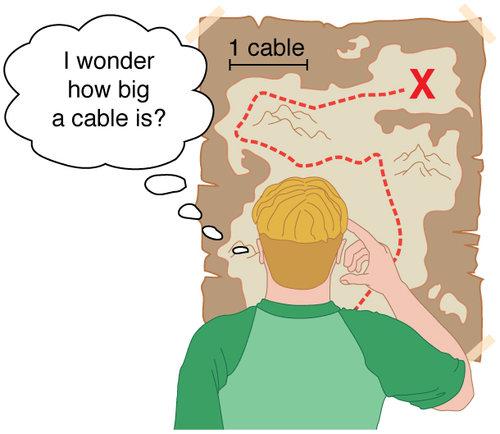
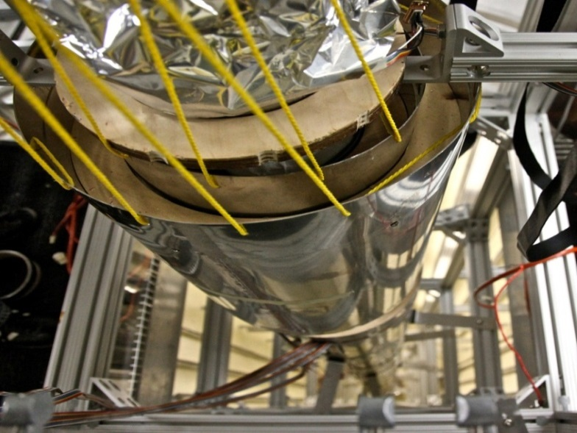
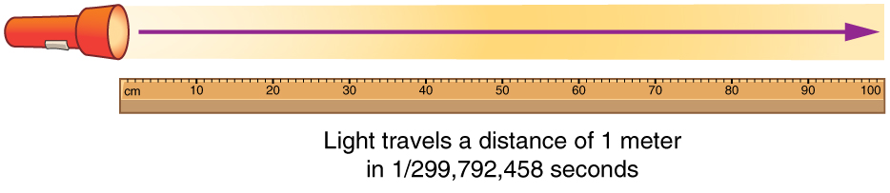
1-01 Introduction, Units, and Uncertainty
Units
  USA uses English system as was used by the British Empire
  Rest of world uses SI system (International System or Metric System)
Fundamental Units - Can only be defined by procedure to measure them
  Time = second (s)
  Distance = meter (m)
  Mass = kilogram (kg)
  Electric Current = ampere (A)
All other units are derived from these 4
Notes:
Meter based on distance light travels in a vacuum in 1/299,792,458 of a second
Second based on time it takes for 9,192,631,770 vibrations of Cesium atoms
Mass based on mass of a platinum-iridium cylinder kept with the old meter standard at the International Bureau of Weights and Measures near Paris

Slide 9
1-01 Introduction, Units, and Uncertainty
Metric Prefixes
  SI system based on powers of ten
  Memorize from T to p
Prefix | Symbol | Value | Prefix | Symbol | Value
exa | E | 10¹⁸ | deci | d | 10⁻¹
peta | P | 10¹⁵ | centi | c | 10⁻²
tera | T | 10¹² | milli | m | 10⁻³
giga | G | 10⁹ | micro | μ | 10⁻⁶
mega | M | 10⁶ | nano | n | 10⁻⁹
kilo | k | 10³ | pico | p | 10⁻¹²
hecto | h | 10² | femto | f | 10⁻¹⁵
decka | da | 10¹ | atto | a | 10⁻¹⁸

Slide 10

1-01 Introduction, Units, and Uncertainty
Unit conversions
Multiply by conversion factors so that the unwanted unit cancels out
Convert 20 Gm to m
  $\frac{20 Gm}{}⋅\left(\frac{1×{10}^{9} m}{1 Gm}\right)$
  $2×{10}^{10} m$

Slide 11

1-01 Introduction, Units, and Uncertainty
Convert 5 cg to kg
  $\frac{5 cg}{}⋅\left(\frac{1×{10}^{−2} g}{1 cg}\right)⋅\left(\frac{1 kg}{1×{10}^{3} g}\right)$
  $\frac{5×{10}^{−2} kg}{1×{10}^{3}}$
  $5×{10}^{−5} kg$

Slide 12

1-01 Introduction, Units, and Uncertainty
Convert 25 km/h to m/s
  $\frac{25 km}{1 h}⋅\left(\frac{1×{10}^{3} m}{1 km}\right)⋅\left(\frac{1 h}{60 min}\right)⋅\left(\frac{1 min}{60 s}\right)$
  $\frac{2.5×{10}^{4} m}{3600 s}$
  $6.94 m/s$

Slide 13
1-01 Introduction, Units, and Uncertainty
Accuracy is how close a measurement is to the correct value for that measurement.
Precision of a measurement system is refers to how close the agreement is between repeated measurements.

Slide 14


1-01 Introduction, Units, and Uncertainty
Accurate but not precise
Precise but not accurate

Slide 15
1-01 Introduction, Units, and Uncertainty
The accuracy and precision of a measuring system leads to uncertainty.
A device can repeated get the same measurement (precise), but always be wrong (not accurate).

Slide 16
1-01 Introduction, Units, and Uncertainty
Measurement lab

Slide 17
1-02 Relative Motion, Distance, and Displacement
In this lesson you will…
• Describe motion in different reference frames
• Define distance and displacement, and distinguish between the two
• Solve problems involving distance and displacement
Standards
M1: Use vector analysis to characterize change in position and motion
Notes:
NAD Standards
M1
Define displacement, relative motion, scalar, vector
Compare vector and scalar quantities
Use vectors to describe relative motion
Use vector analysis to characterize change in position and motion
OpenStax High School Physics 2.1
OpenStax College Physics 2e 2.1-2.2

Slide 18
1-02 Relative Motion, Distance, and Displacement
Kinematics studies motion without thinking about its cause
Position
  The location where something is relative to a coordinate system called a frame of reference
Position is relative to a reference frame
  Earth is the most common reference frame, but it could be something else
Most common coordinate system is x-y coordinate system

Slide 19
1-02 Relative Motion, Distance, and Displacement
Relative motion is how to describe the motion of an object based on different reference frames.
Think of sitting in your car next to a big tractor-trailer truck.
The truck starts to move, but you stay still.
What to you feel?

Slide 20


Notes:
The background moves relative to the screen making it look like the dog is moving. The dog is moving relative to the background, but not moving relative to the screen.
At the end, the background stops moving and the dog moves relative to the screen. The dog is moving relative to the background, but is also moving relative to the screen.

Slide 21


Slide 22
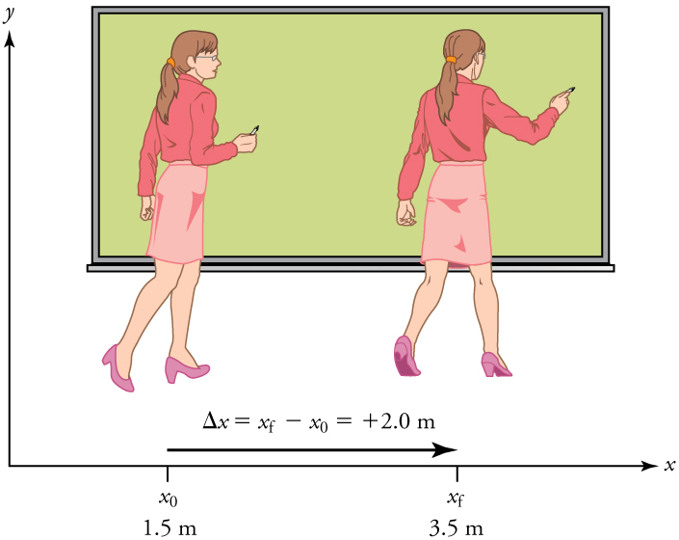


1-02 Relative Motion, Distance, and Displacement
Displacement
  Change in position relative to a reference frame
  $Δd=d_{f}−d_{0}$
  Vector
    Has direction and magnitude
  Path does not matter
  Only depends on final and initial position
Notes:
$$Δd=d_{f}−d_{0}$$
$$Δd=15−5=10 units$$

Slide 23

1-02 Relative Motion, Distance, and Displacement
What is the displacement of the path in the diagram?
Notes:
$$Δd=d_{f}−d_{0}$$
$$Δd=7−\left(−5\right)=12$$

Slide 24
1-02 Relative Motion, Distance, and Displacement
Distance
  Total length of the path taken
  Scalar
    Only has magnitude

Slide 25
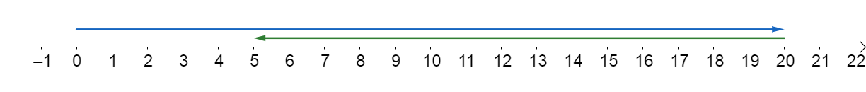

1-02 Relative Motion, Distance, and Displacement
You drive 20 km east, then turn around and drive 15 km west. What is your displacement?
What is your distance traveled?
Notes:
$$Δd=d_{f}−d_{0}$$
$$Δd=5 km−0 km$$
$$5 km$$
5 km east of your starting point
$$20 km+15 km$$
$$35 km$$

Slide 26
1-03 Speed and Velocity and Graphs
In this lesson you will…
• Calculate the average speed of an object
• Relate displacement and average velocity
• Explain the meaning of slope in position vs. time graphs
• Solve problems using position vs. time graphs
Standards
M1: Use vector analysis to characterize change in position and motion
M2: Use graphs to characterize change in position and motion
Notes:
NAD Standards
M1
Define velocity
Compare vector and scalar quantities
M2
Define position-time graph
Interpret graphs from change in position and motion
Create graphs for change in position and motion
Use graphs to interpret slope and area form motion
Use graphs to characterize change in position and motion
OpenStax High School Physics 2.2-2.3
OpenStax College Physics 2e 2.3

Slide 27
1-03 Speed and Velocity and Graphs
Motion graphs lab

Slide 28


1-03 Speed and Velocity and Graphs
Speed
  Rate of change of distance
  $v_{ave}=\frac{distance}{time}$
  $v_{ave}=\frac{dist}{Δt}$
  Scalar (no direction)
Velocity
  Rate of change of displacement
  $v_{ave}=\frac{displacement}{time}$
  $v_{ave}=\frac{Δd}{Δt}=\frac{d_{f}−d_{0}}{t_{f}−t_{0}}$
  Vector

Slide 29
1-03 Speed and Velocity and Graphs
Instantaneous velocity
  Exact velocity at a given moment

Slide 30
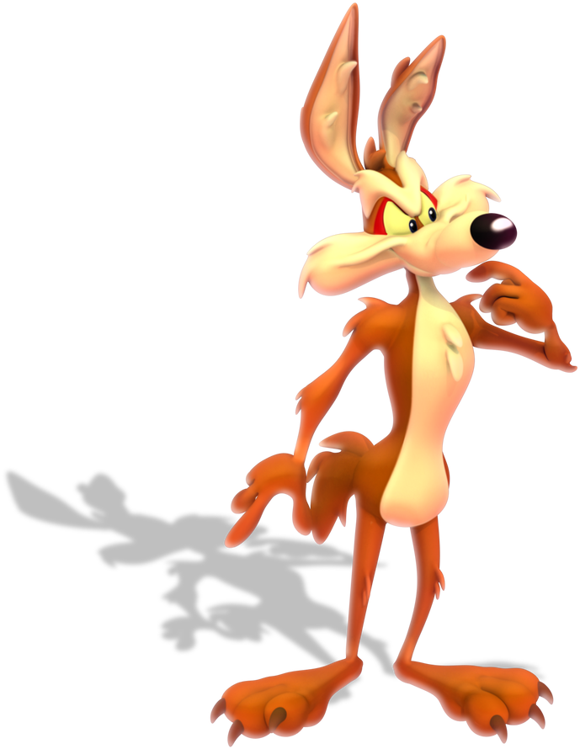
1-03 Speed and Velocity and Graphs
A coyote walks east 2 km, then turns around and walks back west 3 km. If this trip takes 1.5 hours, what is the coyote’s average speed?
Notes:
$$v_{ave}=\frac{distance}{time}$$
$$v_{ave}=\frac{2 km+3 km}{1.5 h}=3.33\frac{km}{h}$$

Slide 31
1-03 Speed and Velocity and Graphs
A coyote walks east 2 km, then turns around and walks back west 3 km. If this trip takes 1.5 hours, what is the coyote’s average velocity?
Notes:
$$v_{ave}=\frac{Δd}{Δt}$$
$$v_{ave}=\frac{−1 km}{1.5 h}=−0.667\frac{km}{h}=0.667\frac{km}{h} west$$

Slide 32
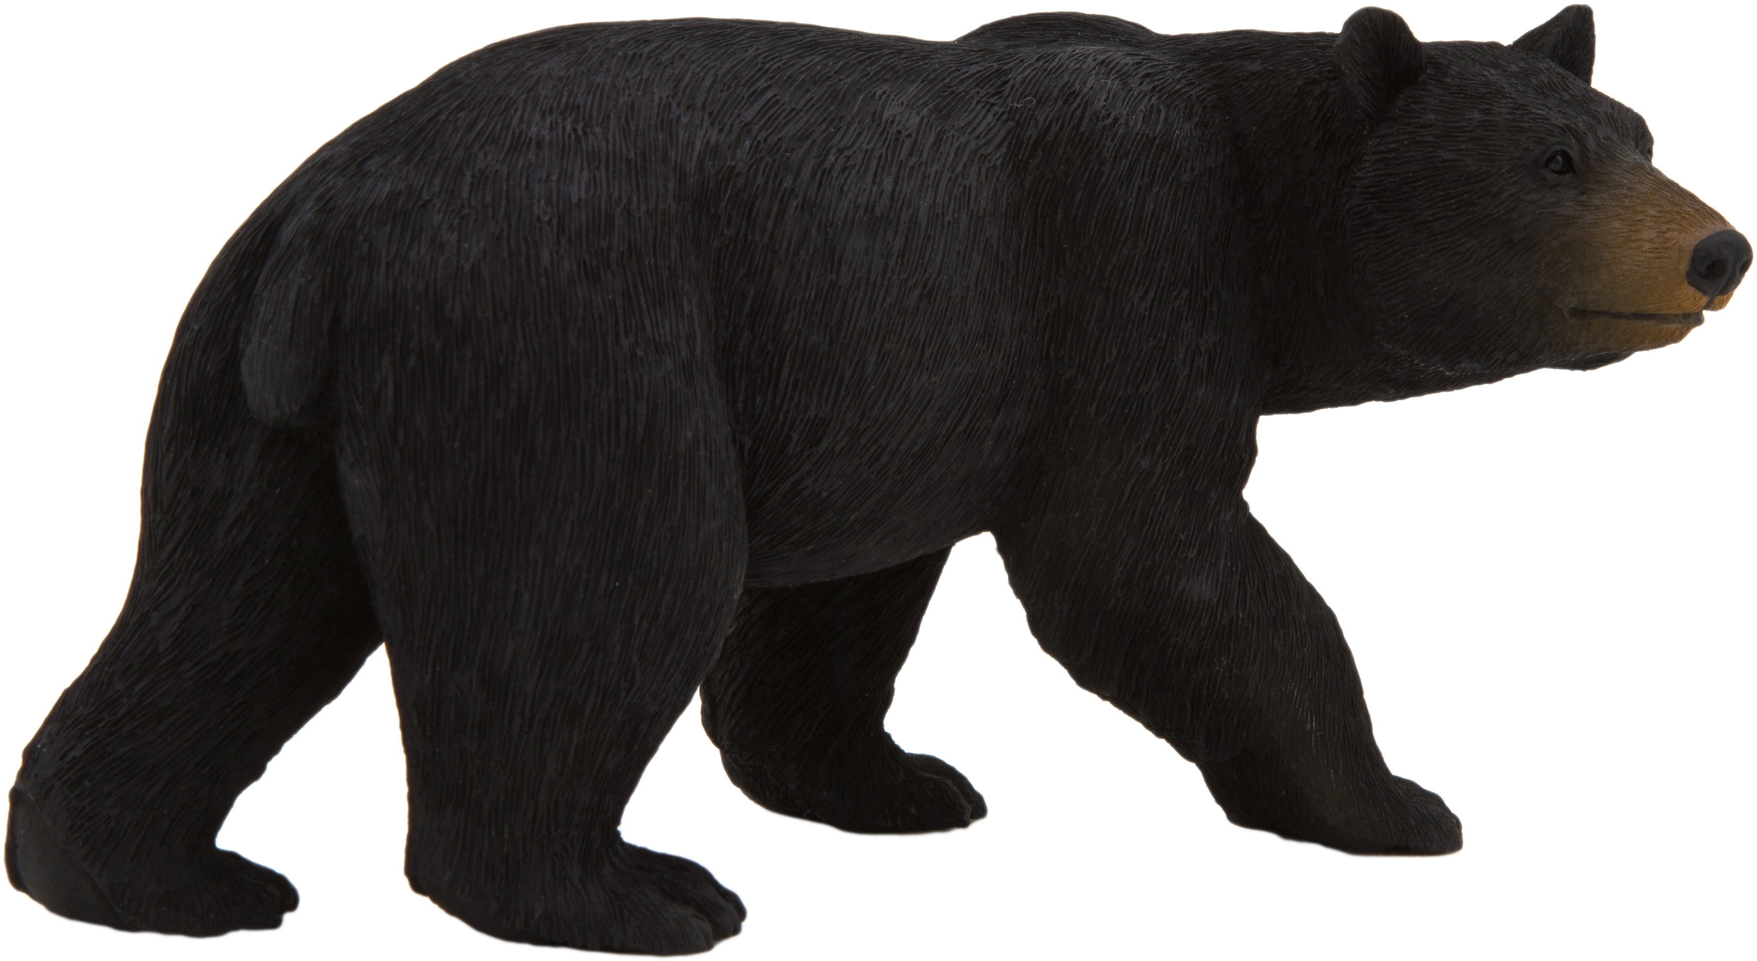

1-03 Speed and Velocity and Graphs
A black bear at top speed can run about 13.5 m/s. If its friend is 50.0 m away, how much time does it have to prepare for a bear hug before the it gets there?
Notes:
$$v_{age}=\frac{Δd}{Δt}$$
$$13.5\frac{m}{s}=\frac{50 m}{Δt}$$
$$13.5\frac{m}{s}Δt=50 m$$
$$Δt=3.70 s$$

Slide 33

1-03 Speed and Velocity and Graphs
Position vs. Time graph
  $slope=\frac{rise}{run}$
  $=\frac{Δd}{Δt}=v$
  Slope of d vs. t is velocity
Notes:
As the dog moves, his position increases as time increases

Slide 34
1-03 Speed and Velocity and Graphs
If the graph is curved, use the slope of the tangent line at the given time

Slide 35
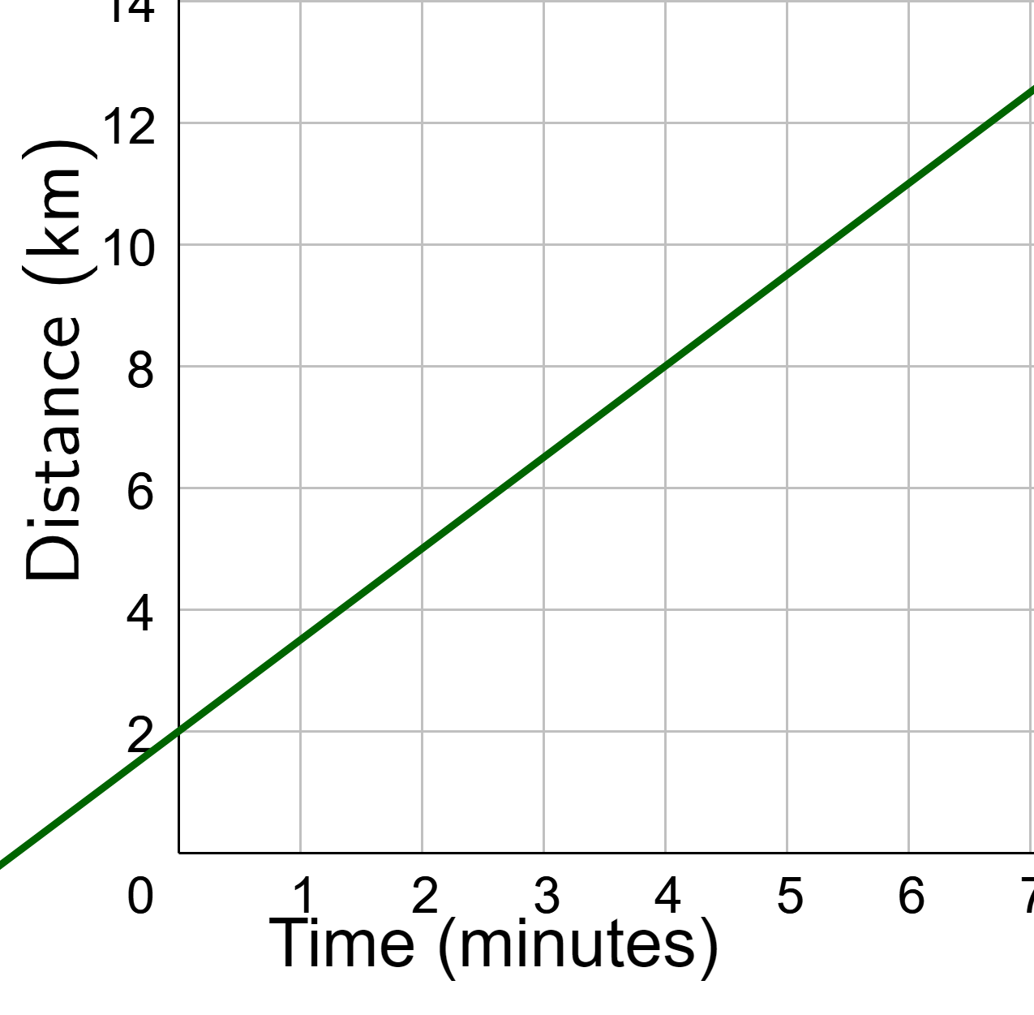
1-03 Speed and Velocity and Graphs
The graph shows the distance a car is from its house. What is the velocity of the car at 5 minutes? (Give the answer in m/s.)
Notes:
Find slope
$$m=\frac{y_{2}−y_{1}}{x_{2}−x_{1}}$$
$$m=\frac{8 km−2 km}{4 \text{min}−0 \text{min}}=\frac{6 km}{4 \text{min}}=1.5 km/min$$

Slide 36
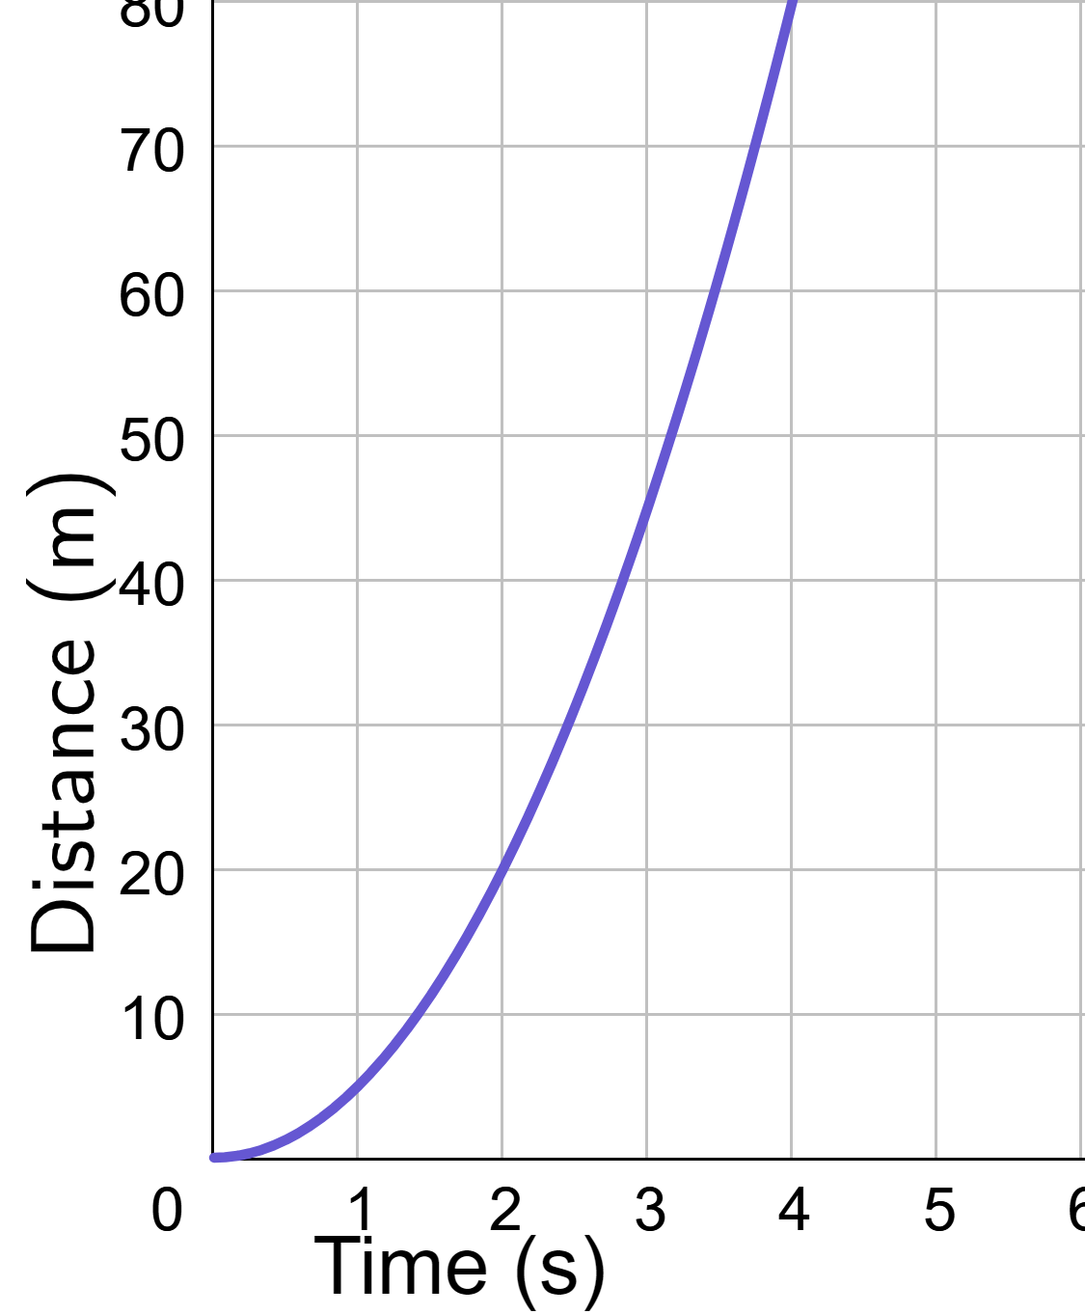
1-03 Speed and Velocity and Graphs
The graph shows the distance a car is from the starting point of a race. What is the velocity of the car at 3 seconds?
Notes:
Draw tangent line at t=3 s.
Find slope of the tangent line.
30 m/s

Slide 37
1-04 Velocity vs Time graphs
In this lesson you will…
Find displacement from a velocity-time graph
Find average velocity from a velocity-time graph
Find acceleration from a velocity-time graph
Standards
M2: Use graphs to characterize change in position and motion
Notes:
NAD Standards
M2
Define velocity-time graph
Interpret graphs for change in position and motion
Create graphs for change in position and motion
Use graphs to interpret the slope and area for motion
Use kinematics to characterize change in position and motion
OpenStax High School Physics 2.4
OpenStax College Physics 2e 2.3, 2.8

Slide 38
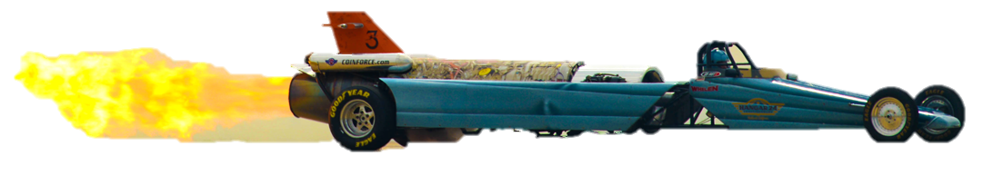
1-04 Velocity vs Time graphs
Acceleration
  Rate of change of velocity
  Slope of velocity vs. time graph
Displacement
  Area between graph and t-axis of a velocity vs. time graph

Slide 39
1-04 Velocity vs Time graphs
Calculate
Displacement over the 30s.
Acceleration over the 30s.
Instantaneous velocity at 20s.
Average velocity over the 30s.
Notes:
area: two parts upper triangle and lower rectangle.
Triangle: $A=\frac{1}{2}bh=\frac{1}{2}\left(30 s\right)\left(165\frac{m}{s}−15\frac{m}{s}\right)=2250 m$
Rectangle: $A=bh=\left(30 s\right)\left(15\frac{m}{s}\right)=450 m$
Add together: $2250 m+450 m=2700 m$
Slope: $m=\frac{y_{2}−y_{1}}{x_{2}−x_{1}}$
$a=\frac{165\frac{m}{s}−15\frac{m}{s}}{30 s −0 s}=5\frac{m}{s^{2}}$
Read from graph. 120 m/s
Find mean: $\overline{v}=\frac{165\frac{m}{s}+15\frac{m}{s}}{2}=90\frac{m}{s}$

Slide 40
1-04 Velocity vs Time graphs
Calculate
Displacement over the first 20s.
Instantaneous acceleration at 30s.
Notes:
Area: estimate with 2 triangles (from 0 to 10s and 10-20s) and 2 rectangles
Triangle (0-10s): $A=\frac{1}{2}bh=\frac{1}{2}\left(10 s\right)\left(210\frac{m}{s}−165\frac{m}{s}\right)=225 m$
Triangle (10-20s): $A=\frac{1}{2}bh=\frac{1}{2}\left(10 s\right)\left(230\frac{m}{s}−210\frac{m}{s}\right)=100 m$
Rectangle (0-10s): $A=bh=\left(10 s\right)\left(165\frac{m}{s}\right)=1650 m$
Rectangle(10-20s): $A=bh=\left(10 s\right)\left(210\frac{m}{s}−0\frac{m}{s}\right)=2100 m$
Total: 225 m + 100 m + 1650 m + 2100 m = 4075 m
Use slope of tangent line (already drawn)
$m=\frac{y_{2}−y_{1}}{x_{2}−x_{1}}$
$a=\frac{260\frac{m}{s}−210\frac{m}{s}}{50 s−0s}=1 m/s^{2}$

Slide 41
1-05 Acceleration
In this lesson you will…
Understand the meaning of positive and negative acceleration
Solve problems involving acceleration
Recognize graphs with constant acceleration
Standards
M1: Use vector analysis to characterize change in position and motion
M2: Use graphs to characterize change in position and motion
M3: Use kinematics equations to characterize change in position and motion
Notes:
NAD Standards
M1
Define acceleration
Use vectors to describe relative motion
Use vector analysis to characterize change in position and motion
M2
Use graphs to characterize change in position and motion
M3
Define acceleration-time graph
Use kinematics equations to solve for missing 1D variables
OpenStax High School Physics 3.1
OpenStax College Physics 2e 2.4, 2.8

Slide 42
1-05 Acceleration
Acceleration graphs lab

Slide 43

1-05 Acceleration
Acceleration
  Rate of change of velocity
  $$\overline{a}=\frac{Δv}{Δt}$$
  $$\overline{a}=\frac{v_{f}−v_{0}}{t_{f}−t_{0}}$$
  $$v=at+v_{0}$$
Vector
Unit: $m/s^{2}$
Notes:
Speeding up
Slowing
Slowing
Speeding up

Slide 44
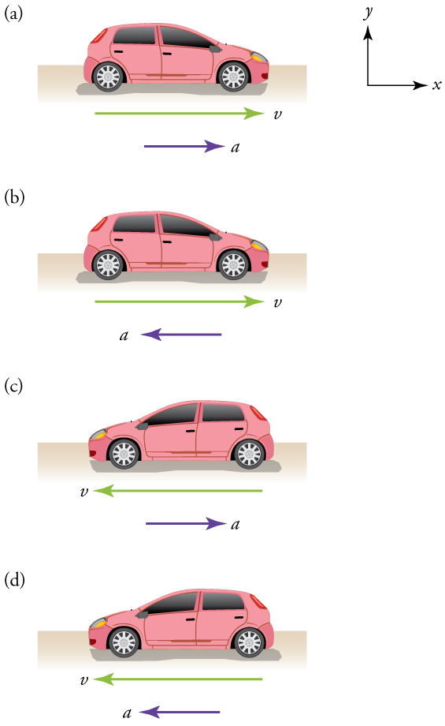
1-05 Acceleration
If the acceleration is same direction as motion, then the object is increasing speed.
If the acceleration is opposite direction as motion, then the object is decreasing speed.
Notes:
Speeding up
Slowing
Slowing
Speeding up

Slide 45
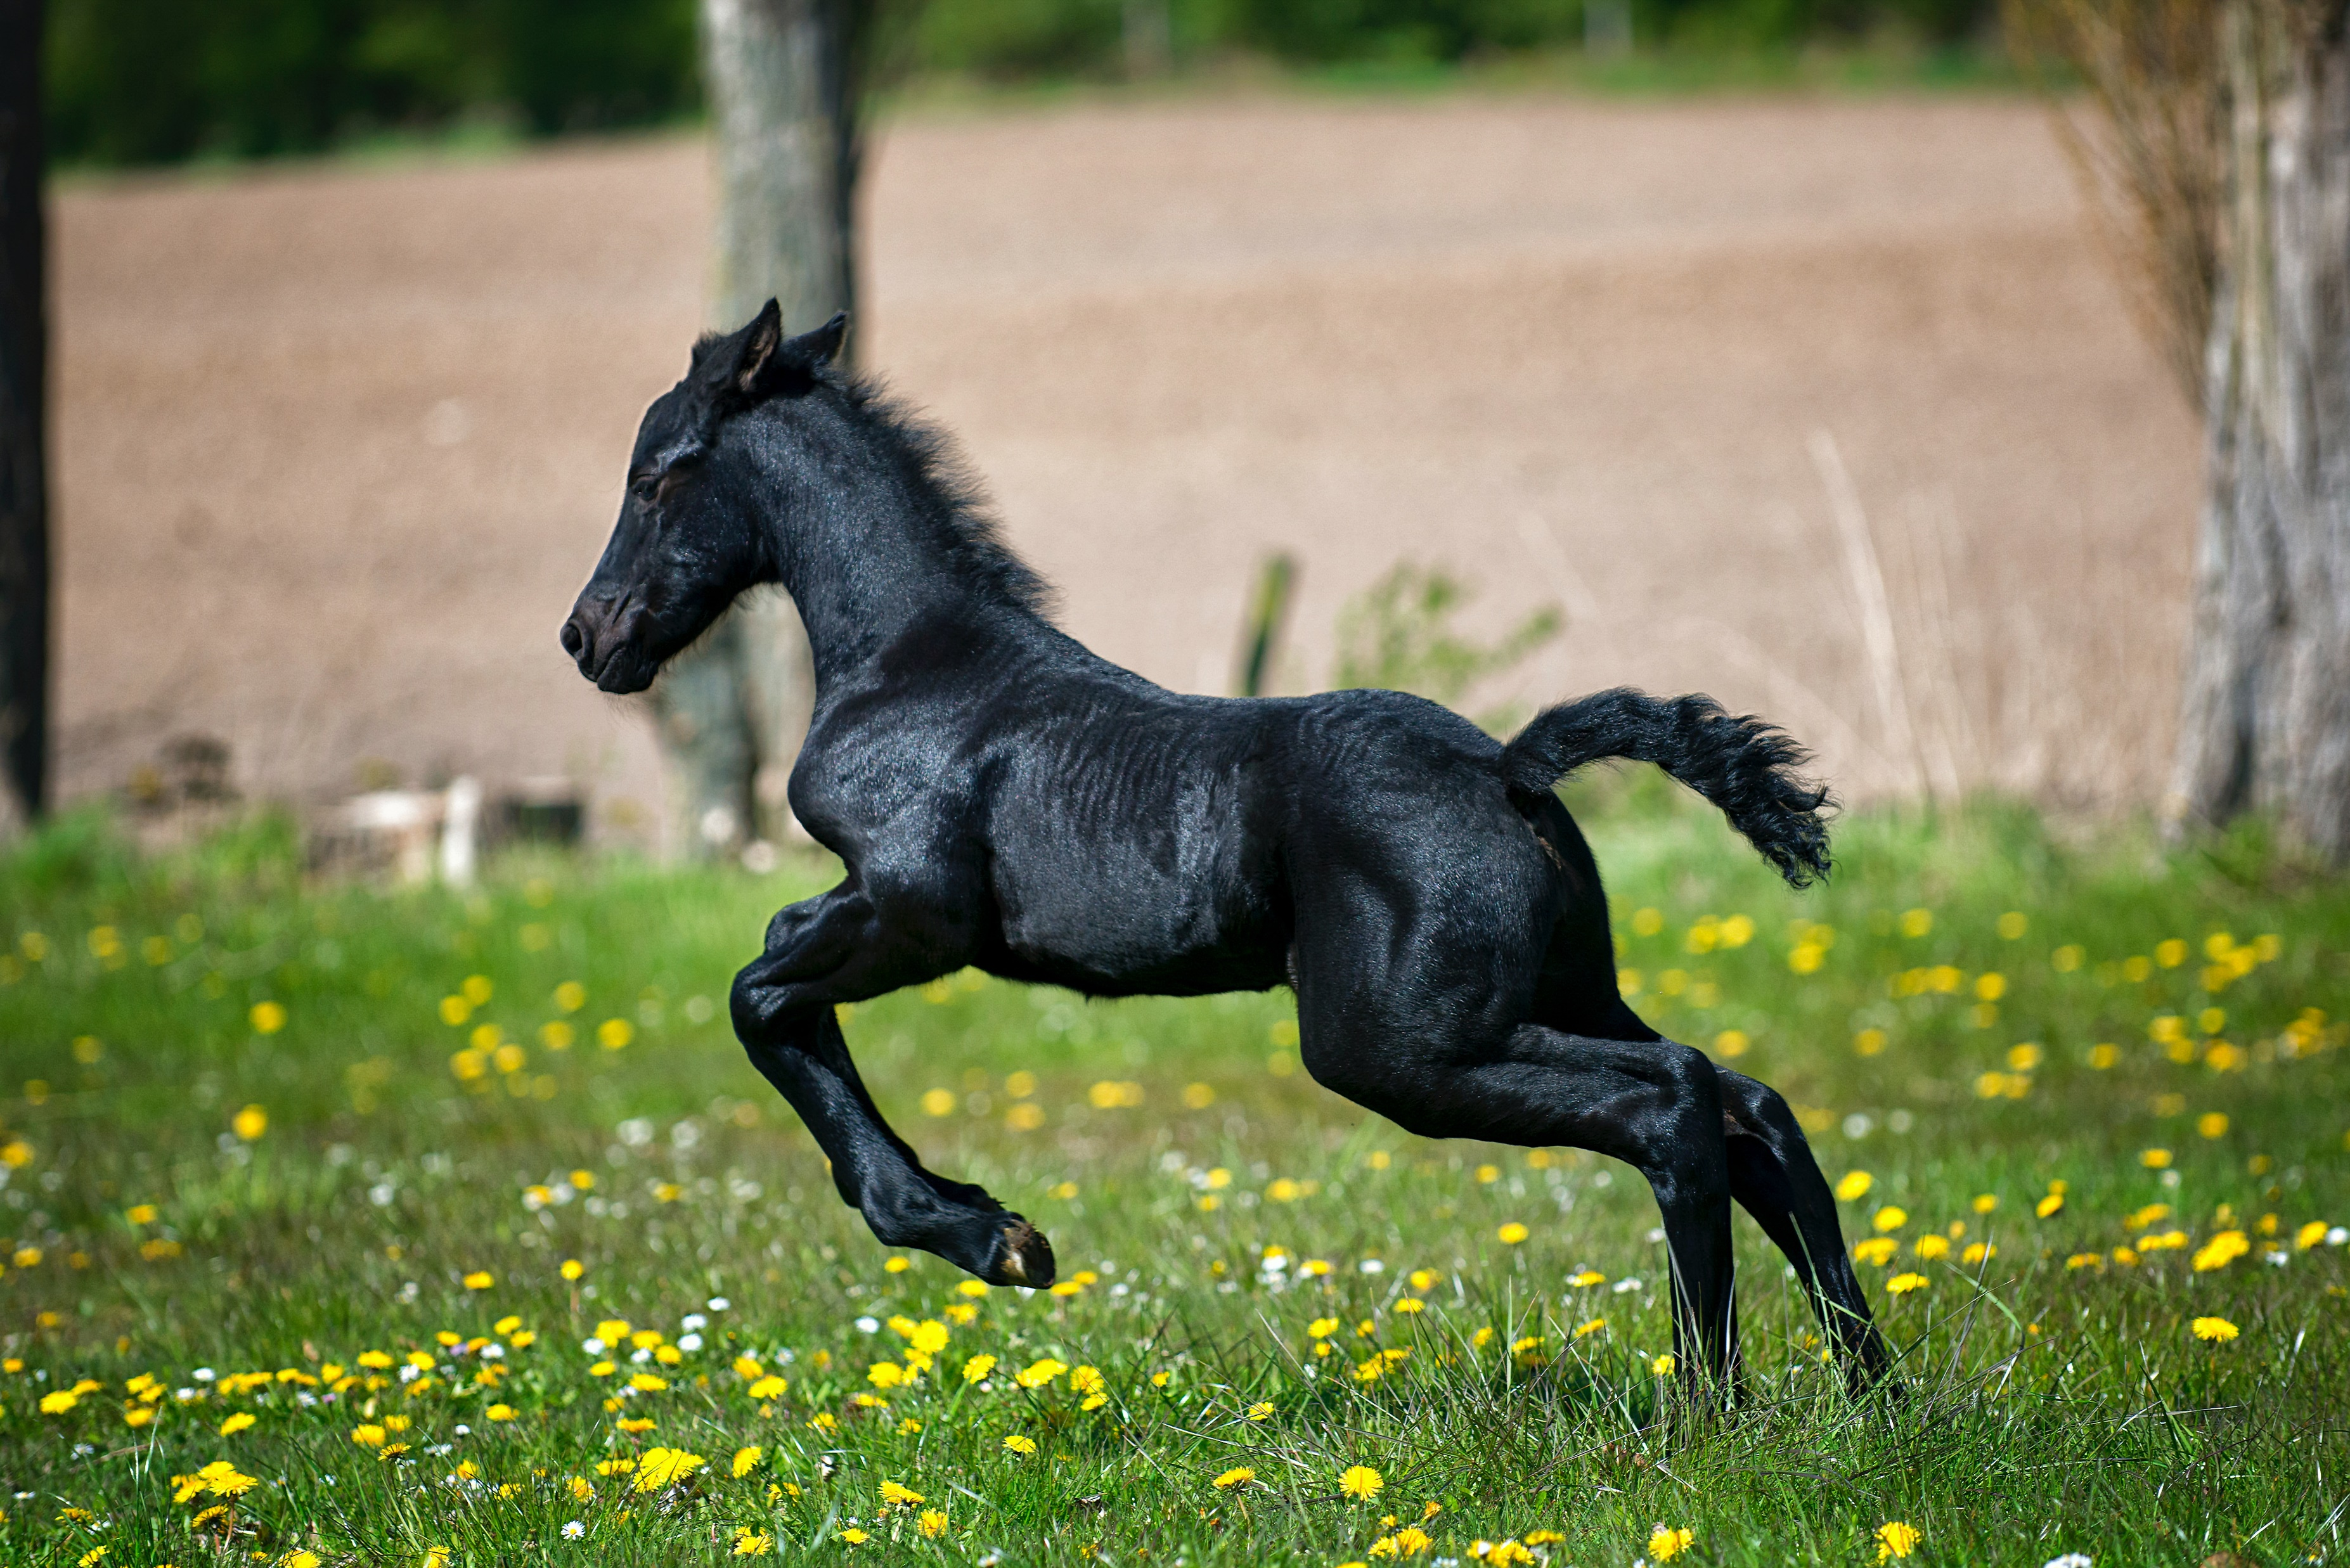
1-05 Acceleration
A horse starts running. If it goes from 0 to 55 km/h in 3.5 s, what is the horse’s acceleration?
Notes:
$$v=\frac{55 km}{h}\left(\frac{{10}^{3} m}{km}\right)\left(\frac{h}{3600 s}\right)=15.278\frac{m}{s}$$
$$\overline{a}=\frac{v_{f}−v_{0}}{t_{f}−t_{0}}$$
$$\overline{a}=\frac{15.278\frac{m}{s}−0\frac{m}{s}}{3.5 s −0 s}=4.37 m/s^{2}$$

Slide 46
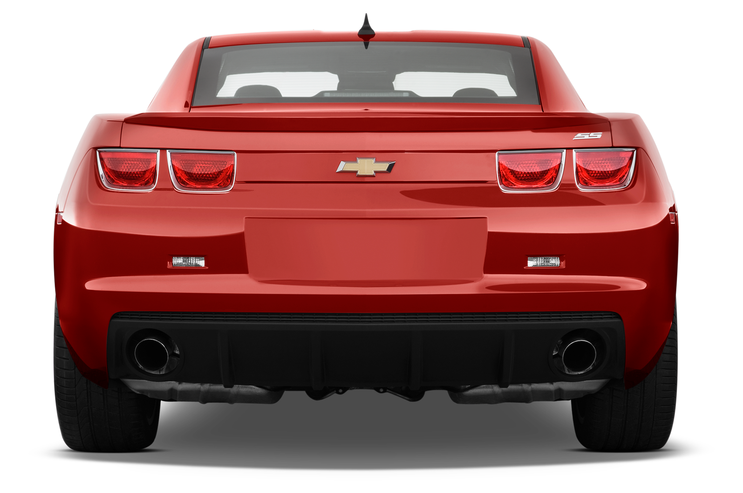
1-05 Acceleration
A car slows from 15 m/s to 10 m/s by an acceleration of 4 m/s². How much time did it take to slow down?
Notes:
$$\overline{a}=\frac{v_{f}−v_{0}}{t_{f}−t_{0}}$$
$$−4\frac{m}{s^{2}}=\frac{10\frac{m}{s}−15\frac{m}{s}}{Δt}$$
$$\left(−4\frac{m}{s^{2}}\right)Δt=−5\frac{m}{s}$$
$$Δt=1.25 s$$

Slide 47

1-05 Acceleration
Constant acceleration
  The graph of position–time is parabolic
    ($d=d_{0}+v_{0}t+\frac{1}{2}at^{2}$ is quadratic)
  The graph of velocity–time is linear
    ($v=at+v_{0}$ is linear)
  The graph of acceleration-time is constant
    ($a=a$)

Slide 48
1-06 Representing Acceleration with Equations Part 1
In this lesson you will…
Use kinematics equations to solve for missing 1D motion variables
Use kinematics equations to characterize change in position and motion
Standards
M3: Use kinematics equations to characterize change in position and motion
Notes:
NAD Standards
M3
Use kinematics equations to solve for missing 1D motion variables
Use kinematics equations to characterize change in position and motion
OpenStax High School Physics 3.2
OpenStax College Physics 2e 2.5-2.6

Slide 49

1-06 Representing Acceleration with Equations Part 1
Assume $t_{0}=0$, so $Δt=t$ and acceleration is constant
$\overline{v}=\frac{d−d_{0}}{t}$
$d=\overline{v}t+d_{0}$ and $\overline{v}=\frac{v_{0}+v}{2}$
$d=\frac{1}{2}\left(v_{0}+v\right)t+d_{0}$

Slide 50

1-06 Representing Acceleration with Equations Part 1
$a=\frac{v−v_{0}}{t}$
$v−v_{0}=at$
$v=at+v_{0}$

Slide 51

1-06 Representing Acceleration with Equations Part 1
$v=at+v_{0}$
$v_{0}+v=at+2v_{0}$
$\frac{v_{0}+v}{2}=\frac{1}{2}at+v_{0}$
$\overline{v}=\frac{1}{2}at+v_{0}$
$d=\overline{v}t+d_{0}$
$d=\left(\frac{1}{2}at+v_{0}\right)t+d_{0}$
$d=\frac{1}{2}at^{2}+v_{0}t+d_{0}$

Slide 52

1-06 Representing Acceleration with Equations Part 1
$v=at+v_{0}$
$t=\frac{v−v_{0}}{a}$
$\overline{v}=\frac{v_{0}+v}{2}$
$d=\overline{v}t+d_{0}$
$d=\left(\frac{v_{0}+v}{2}\right)\left(\frac{v−v_{0}}{a}\right)+d_{0}$
$d−d_{0}=\left(\frac{v^{2}−v_{0}^{2}}{2a}\right)$
$2a\left(d−d_{0}\right)=v^{2}−v_{0}^{2}$
$v^{2}=v_{0}^{2}+2a(d−d_{0})$

Slide 53

1-06 Representing Acceleration with Equations Part 1
$$d=\overline{v}t+d_{0}$$
$$\overline{v}=\frac{v_{0}+v}{2}$$
$$v=at+v_{0}$$
$$d=\frac{1}{2}at^{2}+v_{0}t+d_{0}$$
$$v^{2}=v_{0}^{2}+2a(d−d_{0})$$

Slide 54
1-06 Representing Acceleration with Equations Part 1
Examine the situation to determine which physical principles are involved.
  Maybe draw a picture
List the knowns.
Identify the unknowns.
Find an equation or set of equations that can help you solve the problem.
Substitute the knowns along with their units into the appropriate equation, and Solve
Check the answer to see if it is reasonable: Does it make sense?

Slide 55
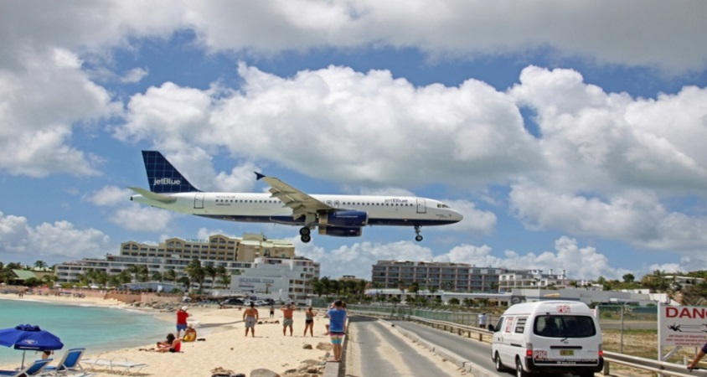

1-06 Representing Acceleration with Equations Part 1
A plane starting from rest accelerates to $40 m/s$ in $10 s$. How far did the plane travel during this time?
Notes:
$$v=40 m/s, t=10 s, v_{0}=0, d_{0}=0, d= ?$$
$$\overline{v}=\frac{v_{0}+v}{2}→\overline{v}=\frac{0+40\frac{m}{s}}{2}=20 m/s$$
$$d=\overline{v}t+d_{0}$$
$$d=\left(20\frac{m}{s}\right)\left(10 s\right)+0$$
$$d=200 m$$

Slide 56

1-06 Representing Acceleration with Equations Part 1
  To avoid an accident, a car decelerates at $0.50 m/s^{2}$ for $3.0 s$ and covers $15 m$ of road. What was the car’s initial velocity?
Notes:
$$a=−0.5\frac{m}{s^{2}}, t=3 s, d=15 m, d_{0}=0, v_{0}= ?$$
$$d=\frac{1}{2}at^{2}+v_{0}t+d_{0}$$
$$15 m=\frac{1}{2}\left(−0.5\frac{m}{s^{2}}\right){\left(3 s\right)}^{2}+v_{0}\left(3 s\right)+0$$
$$15 m=−2.25 m+v_{0}\left(3 s\right)$$
$$17.25 m=v_{0}\left(3 s\right)$$
$$v_{0}=5.75 m/s$$

Slide 57

1-06 Representing Acceleration with Equations Part 1
A cheetah is walking at 1.0 m/s when it sees a zebra 25 m away. What acceleration would be required to reach 20.0 m/s in that distance?
Notes:
$$v=20.0\frac{m}{s}, v_{0}=1.0\frac{m}{s}, d=25 m, d_{0}=0, a= ?$$
$$v^{2}=v_{0}^{2}+2a\left(d−d_{0}\right)$$
$${\left(20\frac{m}{s}\right)}^{2}={\left(1.0\frac{m}{s}\right)}^{2}+2a\left(25 m−0\right)$$
$$400\frac{m^{2}}{s^{2}}=1\frac{m^{2}}{s^{2}}+\left(50 m\right)a$$
$$399\frac{m^{2}}{s^{2}}=\left(50 m\right)a$$
$$a=7.98 m/s^{2}$$

Slide 58
1-06 Representing Acceleration with Equations Part 1
The left ventricle of the heart accelerates blood from rest to a velocity of +26 cm/s. (a) If the displacement of the blood during the acceleration is +2.0 cm, determine its acceleration (in cm/s²). (b) How much time does blood take to reach its final velocity?
Notes:
a) $v^{2}=v_{0}^{2}+2a\left(d−d_{0}\right)$
$${\left(26\frac{cm}{s}\right)}^{2}={\left(0\frac{m}{s}\right)}^{2}+2a\left(2 cm\right)$$
$$676\frac{cm^{2}}{s^{2}}=4a cm$$
$$a=169\frac{cm}{s^{2}}$$
b) $d=\overline{v}t+d_{0};\overline{v}=\frac{v+v_{0}}{2}$
$$\overline{v}=\frac{0\frac{cm}{s}+26\frac{cm}{s}}{2}=13\frac{cm}{s}$$
$$d=\overline{v}t+d_{0}$$
$$2 cm=\left(13\frac{cm}{s}\right)t$$
$$t=0.15 s$$

Slide 59
1-07 Representing Acceleration with Equations Part 2
In this lesson you will…
Define freefall
Use kinematics equations to solve free-fall motion
Use kinematics equations to characterize change in position and motion
Standards
M3: Use kinematics equations to characterize change in position and motion
Notes:
NAD Standards
M3
Define freefall
Use kinematics equations to solve free-fall motion
Use kinematics equations to characterize change in position and motion
OpenStax High School Physics 3.2
OpenStax College Physics 2e 2.7

Slide 60
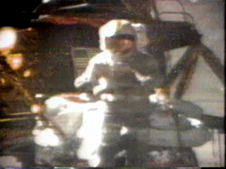

1-07 Representing Acceleration with Equations Part 2
Free fall is when an object is moving only under the influence of gravity
In a vacuum all objects fall at same acceleration
$g=9.80\frac{m}{s^{2}}down$
Any object thrown up, down, or dropped has this acceleration

Slide 61
1-07 Representing Acceleration with Equations Part 2
Do feather falling demo
Real life
  Air resistance
Use the one-dimensional equations of motion

Slide 62
1-07 Representing Acceleration with Equations Part 2
You drop a coin from the top of a hundred story building (1000 m). If you ignore air resistance, how fast will it be falling right before it hits the ground?
Notes:
When solving and taking square root, then use $±$ sign. Took negative here because it was going down.
$$v0=0, v= ?, a=−9.80\frac{m}{s2}, d_{0}=1000 m, d=0 m$$
$$v2=v02+2a\left(d−d_{0}\right)$$
$$v2=0+2(−9.80 m/s2)(0−1000 m)$$
$$v2=19600 m2/s2$$
$$v=−140 m/s$$

Slide 63
1-07 Representing Acceleration with Equations Part 2
How long does it take to hit the ground?
Notes:
$$d=\frac{1}{2}at^{2}+v_{0}t+d_{0}$$
$$0 m=\frac{1}{2}\left(−9.80\frac{m}{s2}\right)t2+0\left(t\right)+1000 m$$
$$−1000 m=−4.90\frac{m}{s2}t2$$
$$204.1 s2=t2$$
$$14.3 s=t$$

Slide 64
1-07 Representing Acceleration with Equations Part 2
A baseball is hit straight up into the air. If the initial velocity was 20 m/s, how high will the ball go?
Notes:
$$v0=20\frac{m}{s}, a=−9.80\frac{m}{s2}, v \left(at top\right)=0, d= ?, d_{0}=0$$
$$v2=v02+2a\left(d−d_{0}\right)$$
$$0=\left(20\frac{m}{s}\right)2+2\left(−9.80\frac{m}{s2}\right)\left(d−0\right)$$
$$−400\frac{m2}{s2}= −19.6\frac{m}{s2}d$$
$$d=20.4 m$$

Slide 65
1-07 Representing Acceleration with Equations Part 2
How long will it be until the catcher catches the ball at the same height it was hit?
Notes:
$$v0=20\frac{m}{s}, a=−9.80\frac{m}{s2}, t= ?, d=0, d_{0}=0$$
$$d=\frac{1}{2}at^{2}+v_{0}t+d_{0}$$
$$0 m=\frac{1}{2}\left(−9.80\frac{m}{s^{2}}\right)t^{2}+\left(20\frac{m}{s}\right)t+0 m$$
$$0=t\left(20\frac{m}{s}−4.90\frac{m}{s^{2}}t\right)$$
$$t=0 s or 20\frac{m}{s}−4.90\frac{m}{s^{2}}t=0$$
$$−4.90\frac{m}{s^{2}}t=−20\frac{m}{s}$$
$$t=4.08 s$$

Slide 66
1-07 Representing Acceleration with Equations Part 2
How fast is it going when catcher catches it?
Notes:
It’s going down.
$$v0=20\frac{m}{s}, a=−9.80\frac{m}{s2}, t= ?, d=0, d_{0}=0$$
$$v^{2}=v_{0}^{2}+2a(d−d_{0})$$
$$v^{2}={\left(20\frac{m}{s}\right)}^{2}+2\left(−9.80\frac{m}{s^{2}}\right)\left(0 m −0 m\right)$$
$$v^{2}={\left(20\frac{m}{s}\right)}^{2}$$
$$v=±20\frac{m}{s} so v=−20 m/s$$

Slide 67
1-07 Representing Acceleration with Equations Part 2
Acceleration of gravity lab

Slide 68
1-08 Vector Addition
In this lesson you will…
Define resultant
Add vectors graphically
Add vectors algebraically
Standards
M1: Use vector analysis to characterize change in position and motion
Notes:
NAD Standards
M1
Define resultant
Add vectors algebraically
OpenStax High School Physics 5.1-5.2
OpenStax College Physics 2e 3.1-3.3

Slide 69
1-08 Vector Addition
Vectors
Vectors are measurements with magnitude and direction
  They are represented by arrows
  The length of the arrow is the magnitude
  The direction of the arrow is the direction

Slide 70
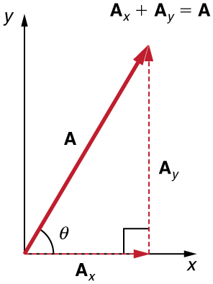

1-08 Vector Addition
Vectors can be represented in component form
  Make a right triangle using the vector as the hypotenuse
  Use sine and cosine to find the horizontal (x) component and the vertical (y) component
  Assign negative signs to any component going down or left
$$\sin\left(θ\right)=\frac{opposite}{hypotenuse} \\ \cos\left(θ\right)=\frac{adjacent}{hypotenuse} \\ \tan\left(θ\right)=\frac{opposite}{adjacent}$$

Slide 71
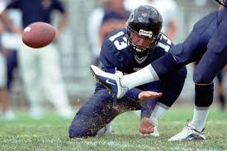
1-08 Vector Addition
A football player kicks a ball at 15 m/s at 30° above the ground. Find the horizontal and vertical components of this velocity.
Notes:
Horizontal: $v_{x}=15\frac{m}{s} cos\left(30°\right)=13.0\frac{m}{s}$
Vertical: $v_{y}=15\frac{m}{s} sin\left(30°\right)=7.5\frac{m}{s}$

Slide 72
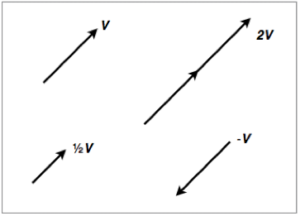
1-08 Vector Addition
Scalar Multiplication
Multiplying a vector by a single number
Draw the vector that many times in a line
Or multiply the components by that number
A negative vector means multiply by −1, so it goes in the opposite direction

Slide 73
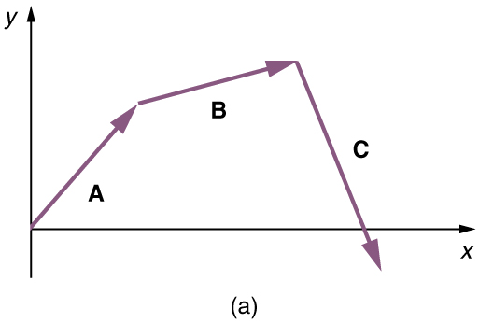
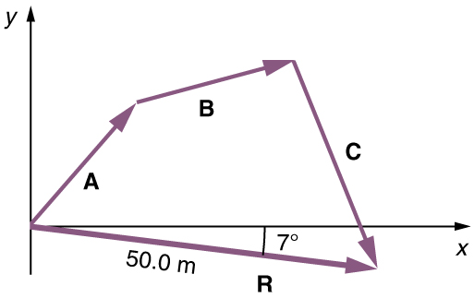
1-08 Vector Addition
Vector Addition - Graphical Method
Draw the first vector.
Draw the second vector where the first one ends (tip-to-tail).
Draw the resultant vector from where the first vector begins to where the second vector ends.
Measure the resultant's length and direction.

Slide 74
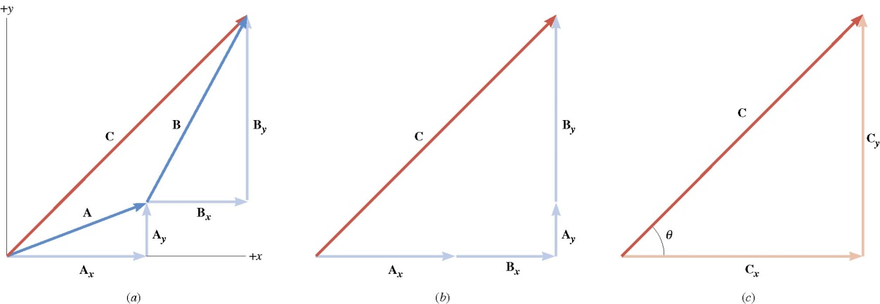
1-08 Vector Addition
Vector Addition – Component Method
Vectors can be described by its components to show how far it goes in the x and y directions.
To add vectors, you simply add the x-component and y-components to get total (resultant) x and y components.
Find the components for all the vectors to be added
Add all the x-components
Add all the y-components
Use the Pythagorean Theorem to find the magnitude of the resultant
Use tan⁻¹ to find the direction (the direction is always found at the tail-end of the resultant)
Note: Drawing pictures and triangles helps immensely.

Slide 75
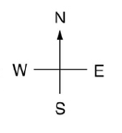
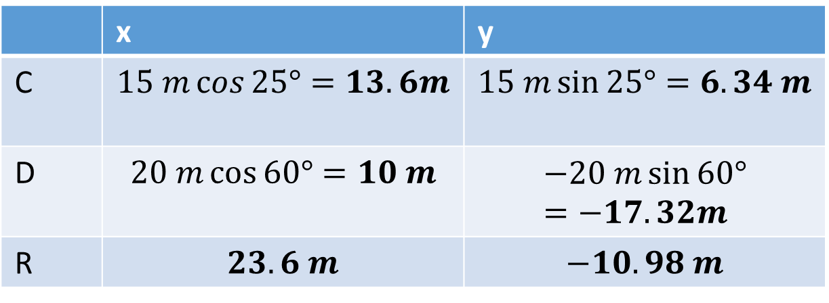


1-08 Vector Addition
Add the follow vectors.
$C=15 m$ at 25° N of E;
$D=20 m$ at 60° S of E
 | x | y
C | $$15 m\cos{25°}=13.6m$$ | $$15 m\sin{25°}=6.34 m$$
D | $$20 m\cos{60°}=10 m$$ | $$−20 m\sin{60°}=−17.32m$$
R | $$23.6 m$$ | $$−10.98 m$$
$R=\sqrt{{\left(23.6 m\right)}^{2}+{\left(−10.98 m\right)}^{2}}=26.0 m$
$θ=\tan^{−1}{\frac{10.98 m}{23.6 m}}=25.0° S of E$
C
D
R

Slide 76

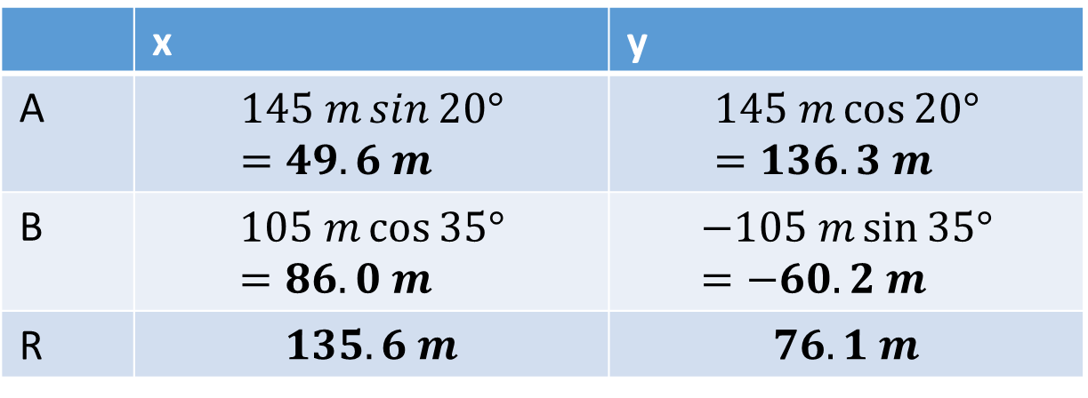
1-08 Vector Addition
A jogger runs 145 m in a direction 20.0° east of north and then 105 m in a direction 35.0° south of east. Determine the magnitude and direction of jogger's position from her starting point.
 | x | y
A | $$145 m\sin{20°}=49.6 m$$ | $$145 m\cos{20°}=136.3 m$$
B | $$105 m\cos{35°}=86.0 m$$ | $$−105 m\sin{35°}=−60.2 m$$
R | $$135.6 m$$ | $$76.1 m$$
$R=\sqrt{{\left(135.6 m\right)}^{2}+{\left(76.1m\right)}^{2}}=155.5 m$
$θ=\tan^{−1}{\frac{76.1 m}{135.6 m}}=29.3° N of E$
B
A
R

Slide 77
1-08 Vector Addition
Do independence of vectors lab

Slide 78
1-09 Projectile Motion
In this lesson you will…
Define projectile motion and 2D motion
Use kinematics equations to solve for missing 2D motion variables
Use kinematics equations to characterize change in position and motion
Standards
M1: Use vector analysis to characterize change in position and motion
M2: Use graphs to characterize change in position and motion
M3: Use kinematics equations to characterize change in position and motion
(Level 4)
Notes:
NAD Standards
M2
Define 2D motion
M3
Define projectile motion
Use kinematics equations to solve for missing 2D motion variables
Use kinematics equations to characterize change in position and motion
OpenStax High School Physics 5.3
OpenStax College Physics 2e 3.4

Slide 79
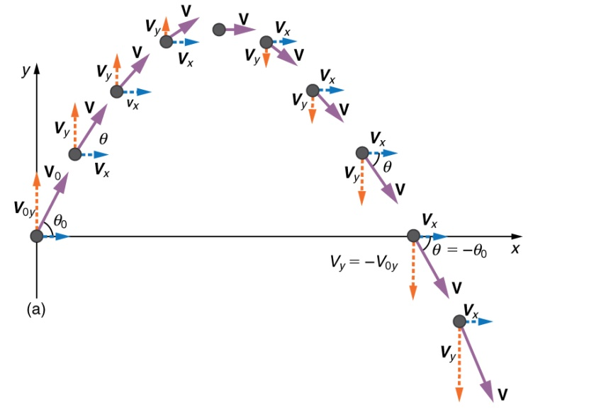

1-09 Projectile Motion
Objects in flight only under influence of gravity
x and y components are independent
  Time is only quantity that is the same in both dimensions
x-component velocity constant since nothing pulling it sideways
  Use $x=v_{0}t$
y-component changes because gravity pulling it down
  Use equations of kinematics
Notes:
Note at highest point, vy = 0

Slide 80

1-09 Projectile Motion
If the starting and ending height are the same, the distance the object goes can be found with the range equation
$$r=\frac{v_{0}^{2}\sin{2θ}}{g}$$

Slide 81
1-09 Projectile Motion
A meatball with v = 5.0 m/s rolls off a 1.0 m high table. How long does it take to hit the floor?
Notes:
y-motion only
$$v_{0y}=0\frac{m}{s}, y_{0}=1.0 m, \\ y=0 m, a_{y}=−9.8\frac{m}{s^{2}}, t= ?$$
$$y=\frac{1}{2}a_{y}t^{2}+v_{0}t+y_{0}$$
$$0 m=\frac{1}{2}\left(−9.8\frac{m}{s^{2}}\right)t^{2}+0\frac{m}{s}t+1.0 m$$
$$−1.0 m=−4.9\frac{m}{s^{2}}t^{2}$$
$$0.20 s^{2}=t^{2}$$
$$0.45 s=t$$

Slide 82
1-09 Projectile Motion
What was the velocity when it hit?
Notes:
Both x and y motion
x-velocity doesn’t change since no acceleration in x
x: $v_{0x}=5.0\frac{m}{s}, t=0.45 s$
y: $v_{0y}=0\frac{m}{s}, y_{0}=1.0 m,$
$$y=0 m, a_{y}=−9.8\frac{m}{s^{2}}, \\ t=0.45 s$$
x-direction
$$v_{x}=5.0\frac{m}{s}$$
y-direction
$$v_{y}=a_{y}t+v_{0y}$$
$$v_{y}=−9.8\frac{m}{s^{2}}\left(0.45 s\right)+0\frac{m}{s}$$
$$v_{y}=−4.4\frac{m}{s}$$
$$v_{R}=\sqrt{{\left(5.0\frac{m}{s}\right)}^{2}+{\left(−4.4\frac{m}{s}\right)}^{2}}=6.7\frac{m}{s}$$
$$θ=\tan^{−1}{\frac{−4.4\frac{m}{s}}{5.0\frac{m}{s}}}=−42°$$
$$6.7\frac{m}{s} at 42° below horizontal$$

Slide 83
1-09 Projectile Motion
A truck (v = 11.2 m/s) turned a corner too sharp and lost part of the load. A falling box will break if it hits the ground with a velocity greater than 15 m/s. The height of the truck bed is 1.5 m. Will the box break?
Notes:
x: $v_{0x}=11.2\frac{m}{s}, v_{x}=11.2\frac{m}{s}$
y: $v_{0y}=0\frac{m}{s}, y_{0}=1.5 m, y=0 m, a_{y}=−9.8\frac{m}{s^{2}}, v_{y}= ?$
y-direction:
$$v_{y}^{2}=v_{0y}^{2}+2a_{y}(y−y_{0})$$
$$v_{y}^{2}={\left(0\frac{m}{s}\right)}^{2}+2\left(−9.8\frac{m}{s^{2}}\right)\left(0−1.5 m\right)$$
$$v_{y}^{2}=29.4\frac{m^{2}}{s^{2}}$$
$$v_{y}=−5.42 m/s$$
$$v_{R}=\sqrt{{\left(11.2\frac{m}{s}\right)}^{2}+{\left(−5.42\frac{m}{s}\right)}^{2}}$$
$v_{R}=12.4 m/s$ The box doesn’t break

Slide 84
1-09 Projectile Motion
While driving down a road a bad guy shoots a bullet straight up into the air. If there was no air resistance where would the bullet land – in front, behind, or on him?
Notes:
If air resistance present, bullet slows and lands behind.
No air resistance the v_{x} doesn’t change and bullet lands on him.

Slide 85
1-09 Projectile Motion
If a gun were fired horizontally and a bullet were dropped from the same height at the same time, which would hit the ground first?
Notes:
Hit at the same time since they fall down the same distance and have the same initial y-velocity.

Slide 86
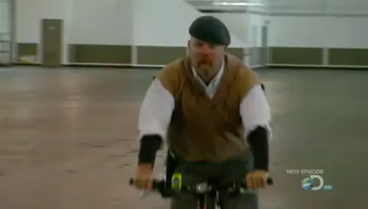
01-08 Projectile Motion
Notes:
Watch MythBusters bullet drop video

Slide 87
1-09 Projectile Motion
A batter hits a ball at 35° with a velocity of 32 m/s. How high did the ball go?
Notes:
x: $v_{0x}=32\frac{m}{s}\cos{35°}=26.2\frac{m}{s}$
y: $y_{0y}=32\frac{m}{s}\sin{35°}=18.4\frac{m}{s}, a_{y}=−9.8\frac{m}{s^{2}}, y_{0}=0 m, y= ?, v_{y}=0\frac{m}{s}$
y-direction:
$$v_{y}^{2}=v_{0y}^{2}+2a_{y}\left(y−y_{0}\right)$$
$$0^{2}={\left(18.4\frac{m}{s}\right)}^{2}+2\left(−9.8\frac{m}{s^{2}}\right)\left(y−0\right)$$
$$0=338.9\frac{m^{s}}{s^{2}}−19.6\frac{m}{s^{2}}y$$
$$y=17 m$$

Slide 88
1-09 Projectile Motion
How long was the ball in the air?
Notes:
x: $v_{0x}=32\frac{m}{s}\cos{35°}=26.2\frac{m}{s}$
y: $y_{0y}=32\frac{m}{s}\sin{35°}=18.4\frac{m}{s}, a_{y}=−9.8\frac{m}{s^{2}}, y_{0}=0 m, y=0 m, t= ?$
y-direction:
$$y=\frac{1}{2}a_{y}t^{2}+v_{0y}t+y_{0}$$
$$0=\frac{1}{2}\left(−9.8\frac{m}{s^{2}}\right)t^{2}+\left(18.4\frac{m}{s}\right)t+0$$
$$0=t\left(−4.9\frac{m}{s^{2}}t+18.4\frac{m}{s}\right)$$
$$t=0 or t=3.8 s$$

Slide 89
1-09 Projectile Motion
How far did the ball go?
Notes:
x: $v_{0x}=32\frac{m}{s}\cos{35°}=26.2\frac{m}{s},$ $t=3.8 s, x= ?$
x-direction:
$$x=v_{0x}t+x_{0}$$
$$x=26.2\frac{m}{s}\left(3.8 s\right)+0 m$$
$$x=98 m$$

Slide 90
1-09 Projectile Motion
A projectile launcher shoots a ball with v₀ = 11 m/s. If the ball lands 9.38 m away horizontally and 2 m higher, at what angle was the ball launched?
Notes:
$$x=v_{0}t$$
$$x=v_{0}\left(\cos{θ}\right)t$$
$$9.38 m=11\frac{m}{s}\left(\cos{θ}\right)t$$
$$y=\frac{1}{2}at^{2}+v_{0}t+y_{0}$$
$$2=\frac{1}{2}\left(−9.8\frac{m}{s^{2}}\right)t^{2}+\left(11\frac{m}{s}\right)\left(\sin{θ}\right)t+0$$
$$0=−4.9\frac{m}{s^{2}}t^{2}+11\frac{m}{s}\left(\sin{θ}\right)t−2$$
$$x=v_{0}t$$
$$9.38 m=11\frac{m}{s}\left(\cos{θ}\right)t$$
$$\frac{9.38 s}{11\cos{θ}}=t$$
Substitute (and drop units for convenience)
$$0=−4.9{\left(\frac{9.38}{11\cos{θ}}\right)}^{2}+11\sin{θ}\left(\frac{9.38}{11\cos{θ}}\right)−2$$
$$0=−3.563 \sec^{2}θ+9.38 tan θ−2$$
sec² θ = 1 + tan² θ
$$0=−3.563\left(1+\tan^{2}{θ}\right)+9.38\tan{θ}−2$$
$$0=−3.563−3.563\tan^{2}{θ}+9.38\tan{θ}−2$$
$$0=−3.563\tan^{2}{θ}+9.38\tan{θ}−5.563$$
Solve to tan θ with the quadratic formula
$$\tan{θ}=\frac{−9.38±\sqrt{{9.38}^{2}−4\left(−3.563\right)\left(−5.563\right)}}{2\left(−3.563\right)}$$
$$\tan{θ}=1.73024$$
$$θ=60.0°$$

